Slide 1
Exercises of ERD
Hemn Barzan

Slide 2
1. Use the following business rules to create a crow’s foot ERD.
Write all appropriate connectivity's and cardinalities in the ERD.
a. A department employs many employees, but each employee is employed by only one department.
b. Some employees, known as “rovers,” are not assigned to any department.
c. A division operates many departments, but each department is operated by only one division.
d. An employee may be assigned many projects, and a project may have many employees assigned to it.
e. A project must have at least one employee assigned to it.
f. One of the employees manages each department, and each department is managed by only one employee.
g. One of the employees runs each division, and each division is run by only one employee.

Slide 3
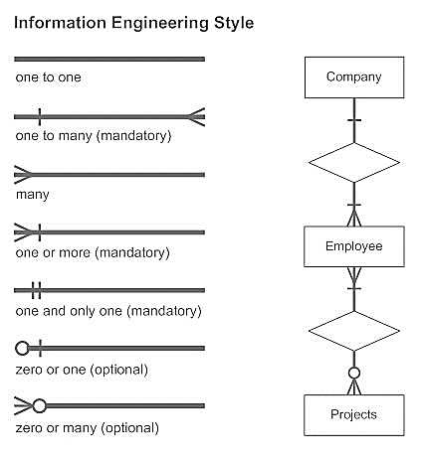
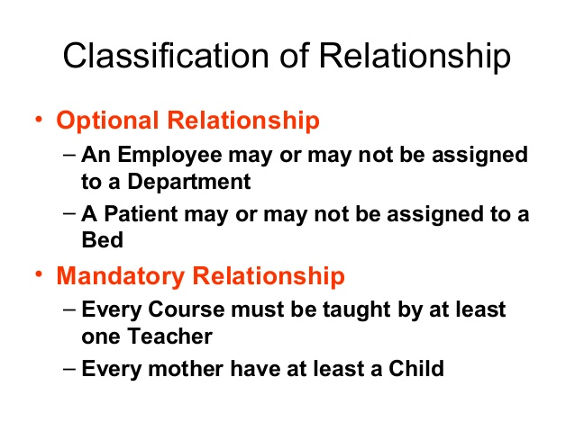
Entity-Relationship Diagram Symbols
A Mandatory relationship is where there must be at least one matching record in each entity

Slide 4
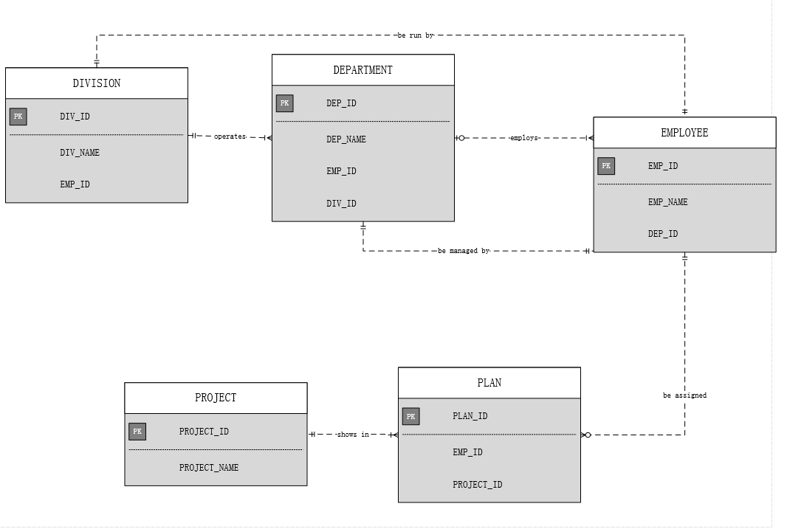
Notes:
Division=شعبة=师

Slide 5
2. The Jonesburg County Basketball Conference (JCBC) is an amateur basketball association. Each city in the county has one team as its representative. Each team has a maximum of 12 players and a minimum of 9 players. Each team also has up to three coaches (offensive, defensive, and physical training coaches). During the season, each team plays two games (home and visitor) against each of the other teams. Given those conditions, do the following:
a. Identify the connectivity of each relationship.
b. Identify the type of dependency that exists between CITY and TEAM.
c. Identify the cardinality between teams and players and between teams and city.
d. Identify the dependency between coach and team and between team and player.
e. Draw the Chen and Crow’s Foot ERDs to represent the JCBC database.
f. Draw the UML class diagram to depict the JCBC database.

Slide 6
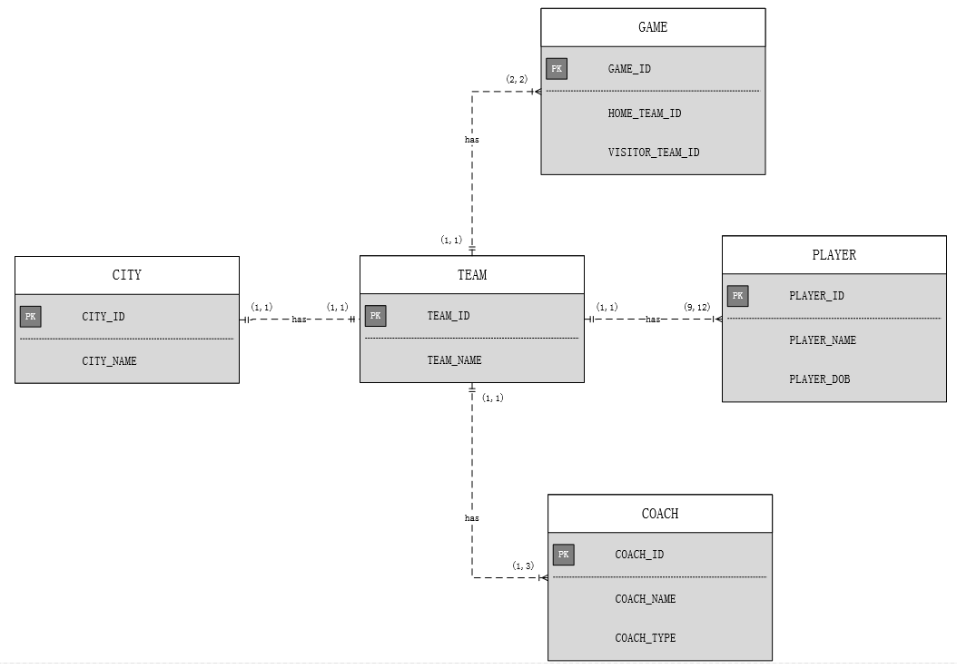

Slide 7
3. Create an ERD based on the Crow’s Foot notation, using the following requirements:
a. An INVOICE is written by a SALESREP. Each sales representative can write many invoices, but each invoice is written by a single sales representative.
b. The INVOICE is written for a single CUSTOMER. However, each customer can have many invoices.
c. An INVOICE can include many detail lines (LINE), each of which describes one product bought by the customer.
d. The product information is stored in a PRODUCT entity.
e. The product’s vendor information is found in a VENDOR entity.

Slide 8
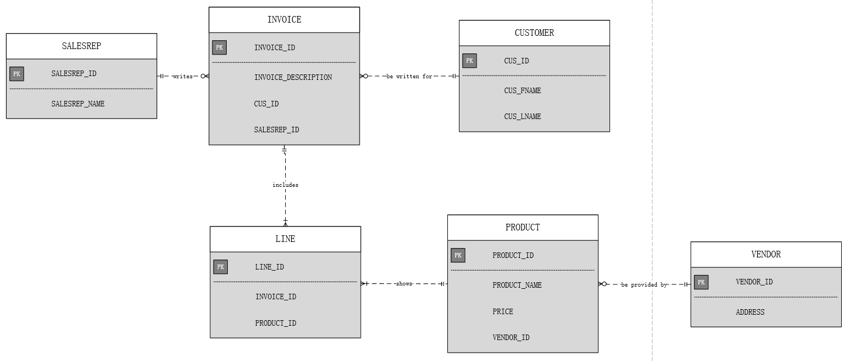
Notes:
Vendor=seller

